Slide 1




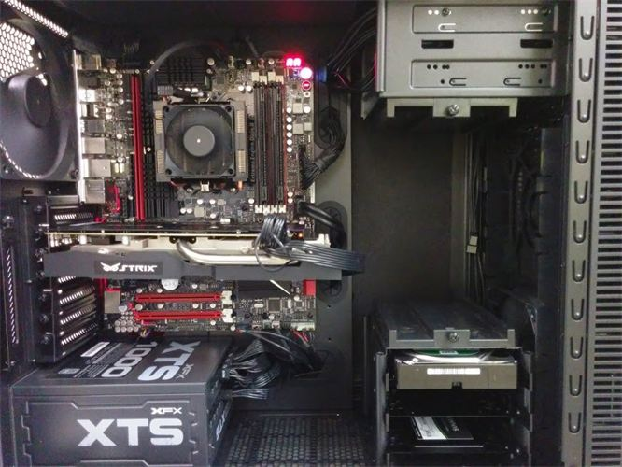

Cooling Fan
CPU
R.A.M
Motherboard
Optical Disk Drive (DVD)
USB Expansion Ports
Monitor Port
Ethernet Port
Audio Ports
Graphics Card
Hard disk drive
Power Supply

